Slide 1


Session 10. Tabbed and Composite Screens
Transact (T24) Technical Induction Training
Minsk, 2021

Slide 2




Agenda
Tabbed and Composite Screens in UXP Overview
Tabbed and Composite Screens creation
Tabbed and Composite Screens settings
Workshops

Slide 3

Tabbed and Composite Screens in UXP
In case of design, UXP Browser with GOD mode provide functionality for:
Enquiry – You can create/amend in the same way like you do before: DS or from Browser
Version - You can create/amend in the same way like you do before: DS or from Browser
Menu - You can create/amend in the same way like you do before: DS or from Browser
COS – You should work with DS
Create/amend from DS directly
Import to DS and generate code for Transact (T24)

Slide 4
Tabbed and Composite Screens in UXP
EB.COMPOSITE.SCREEN
Application that allows user to create COS manually
UXP Browser
T24.UXPB.COS
Additional application with some interface options
EB.TABBED.SCREEN
Application that allows user to create COS manually

Slide 5
Tabbed and Composite Screens in UXP
Feature | Plan
Nested COS menus | Not planned
BROWSER.TOOLS support | We do support ‘doCommand()’ which is the majority of tools. We do support custom Javascript. Remainder is not supported.
BROWSER.TOOLBAR | We do not support.
Field defaulting via JBC (Where Version JBC code defaults a field value that is not defined in the model) | If the version is invoked via a drill down then the workaround is to pass the variable (set by the JBC) using the drill down definition. This feature cannot be supported like the old browser; this is because IRIS is stateless.
COS tools | Not planned
EB.DYNAMIC.ATTRIBUTE | Not planned
EB.CREATE.CONTEXT.WORKFLOW | Not supported
Optimizing locking concept | Not supported

Slide 6
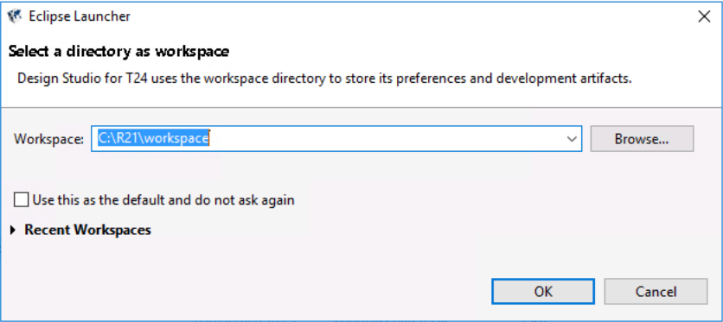
Tabbed and Composite Screens in UXP
How to launch Design Studio
Launch c:\R21\design_studio.bat
Click ok to set a directory:

Slide 7
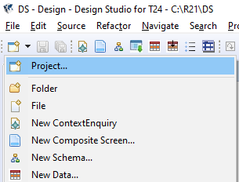
Tabbed and Composite Screens in UXP
How to launch Design Studio
1
2

Slide 8
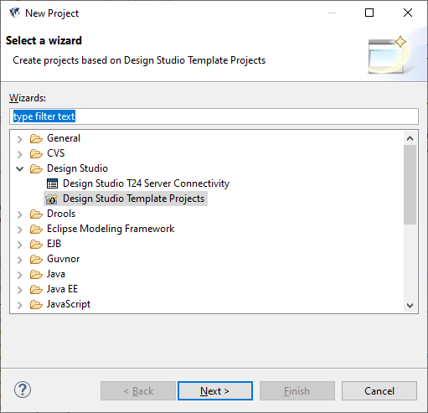
Tabbed and Composite Screens in UXP
How to launch Design Studio
1
2

Slide 9
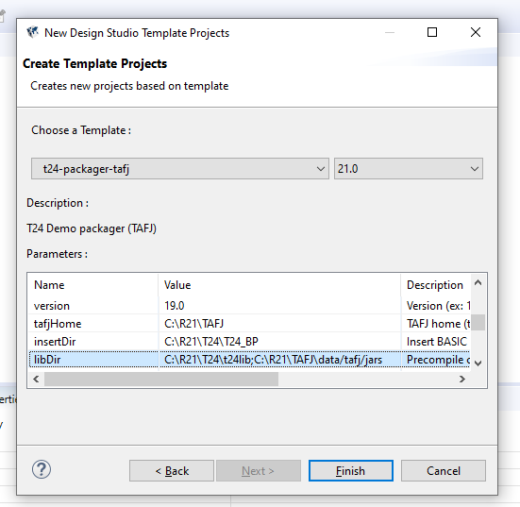
Tabbed and Composite Screens in UXP
How to launch Design Studio
1. Choose a template:
2. Fill 3 fields here:
tafj.home = C:\R21\TAFJ
temn.tafj.directory.insert = C:\R21\T24\T24_BP
temn.tafj.directory.precompile =C:\R21\T24\t24lib;C:\R21\TAFJ\data/tafj/jars
3

Slide 10
T24 Tabbed Screens
T24 Tabbed Screens

Slide 11
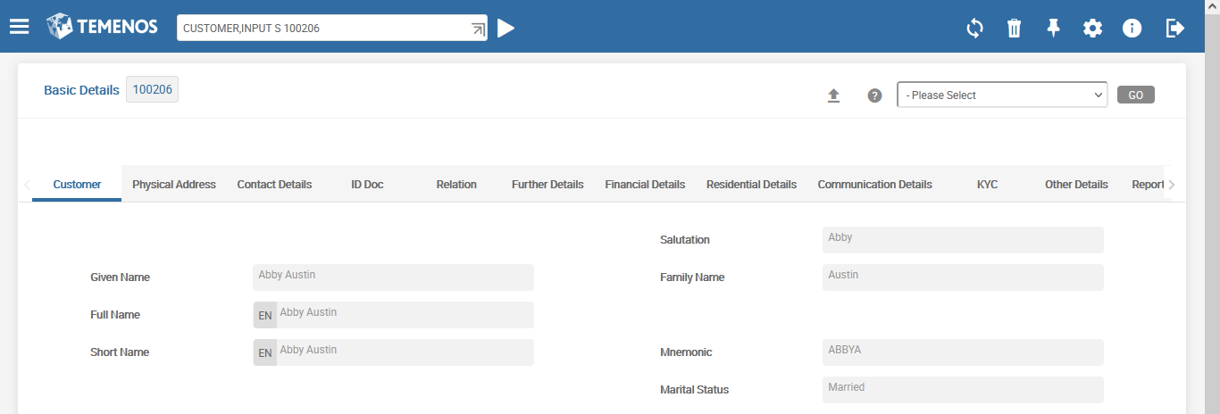
T24 Tabbed Screens
Tabbed Screen can include the data from different applications (unlike Versions with Tabs).
This is an example of Version with Tabs for Customer application. All Tabs include fields only from one chosen record of Customer application.

Slide 12
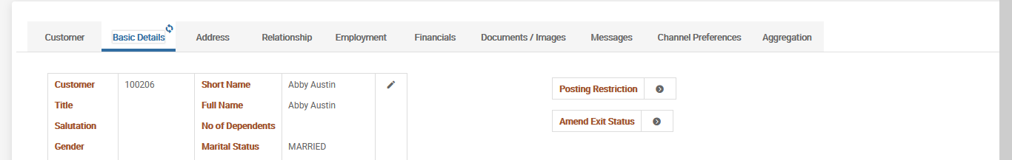
T24 Tabbed Screens
This is an example of Tabbed Screen. Each Tab can include the data from different applications. For example, for one chosen Customer we can see in one Tab – Address (from one application), in another Tab – Documents (from another application) etc.
Samples of Tab Content:
COS: Composite Screen
ENQ: Enquiry
MENU: Menu
TXN: Version
URL: Reference to web-site
UTILITY: Routine (T24 program)
Notes:
TAB CUSTOMER.OVERVIEW.CSM from COS CUSTOMER.OVERVIEW.CSM from ENQ CUSTOMER.SCV

Slide 13
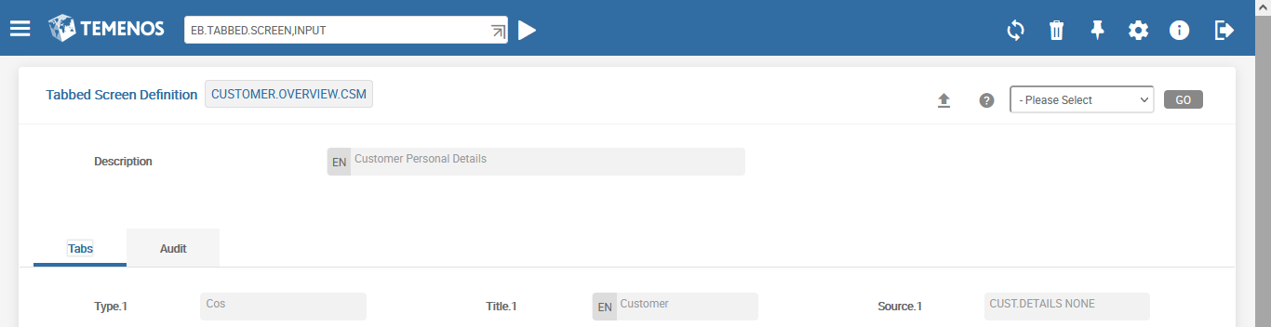
T24 Tabbed Screens
Executing new version creation or editing existing version:
Menu> Admin Menu> Implementation Utilities>Customization> Screen Designer > New Tabbed Screen
…or just EB.TABBED.SCREEN,INPUT from command line:

Slide 14
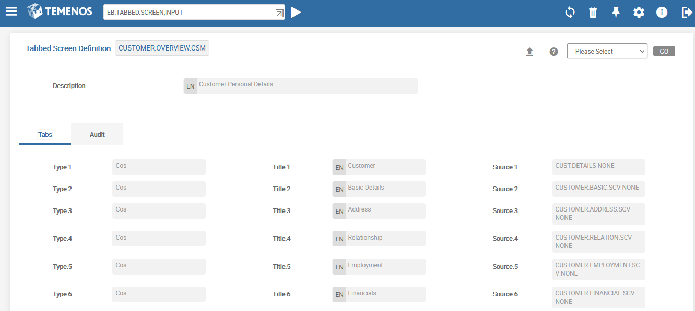
T24 Tabbed Screens
Content (for this string it’s a name of COS)
Type of content
Name of tab

Slide 15
Demo 1 – Tabbed Screen Creation
Create Tabbed Screen for grouping of different tasks execution in single browser window:
1-st Tab in the screen – for basic customer details (ENQ CUSTOMER.BASIC.SCV)
2-nd Tab in the screen – for account opening

Slide 16
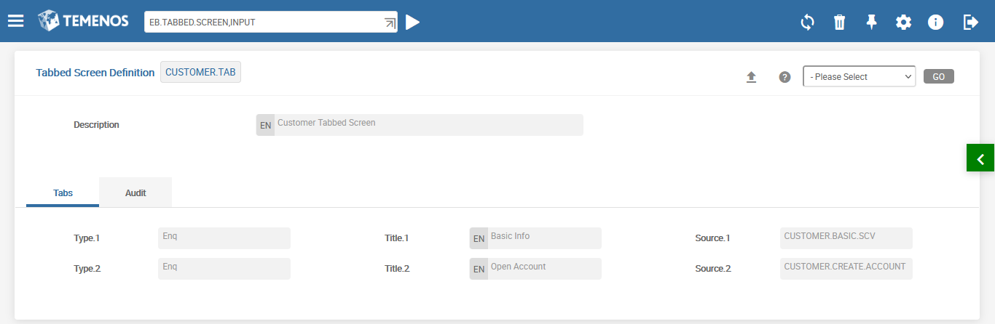
Demo 1 – Tabbed Screen Creation

Slide 17
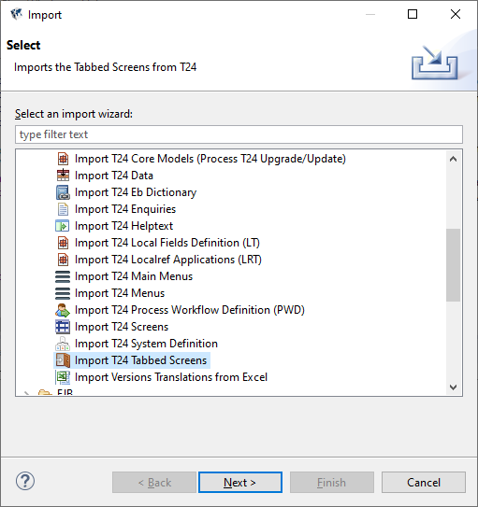
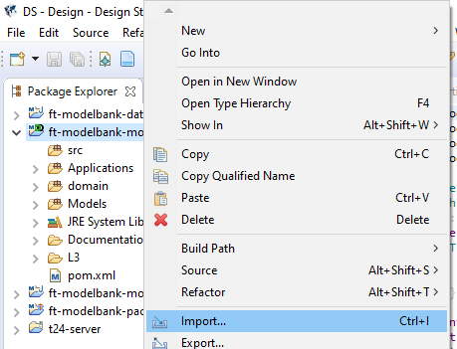
Demo 1 – Tabbed Screen Creation
Import this screen via Design Studio

Slide 18
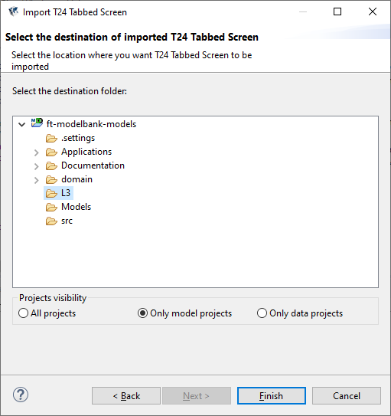
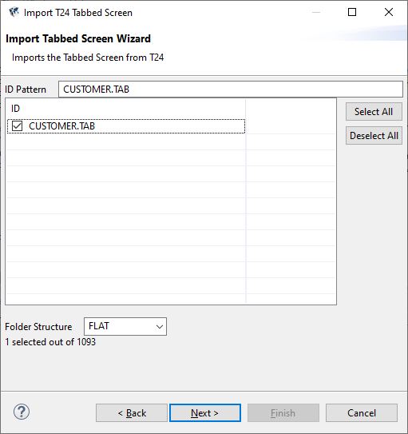
Demo 1 – Tabbed Screen Creation
Import this screen via Design Studio

Slide 19
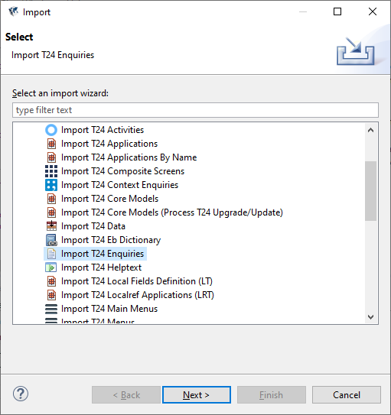
Demo 1 – Tabbed Screen Creation
Import used enquiries via Design Studio

Slide 20
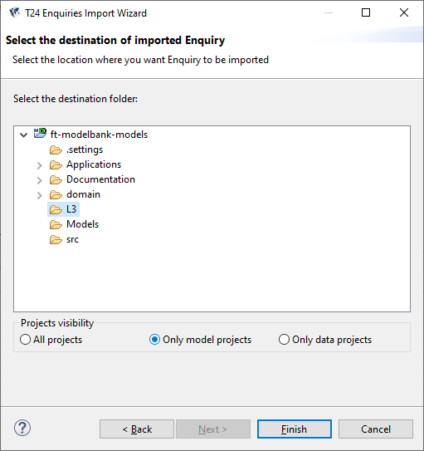
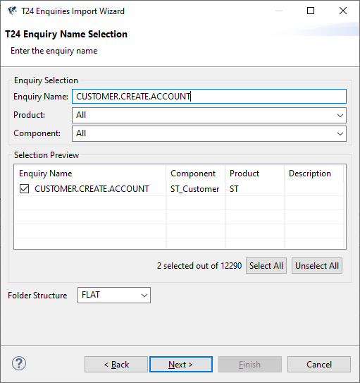
Demo 1 – Tabbed Screen Creation
Import used enquiries via Design Studio

Slide 21
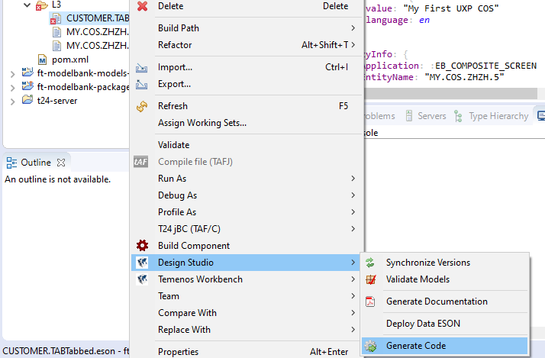
Demo 1 – Tabbed Screen Creation
Import this screen via Design Studio and generate code:

Slide 22
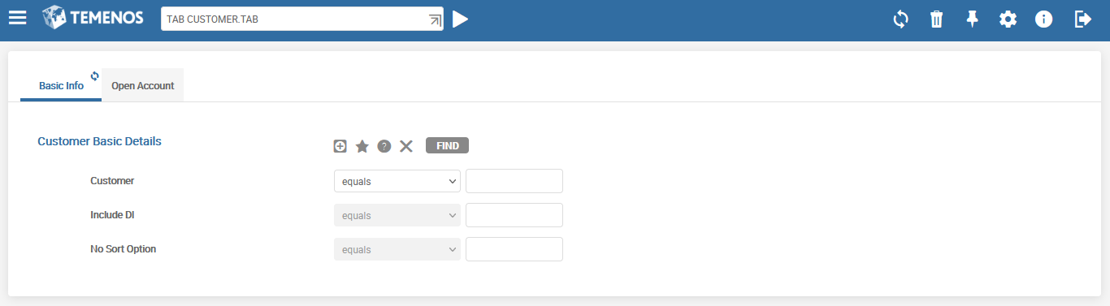
Demo 1 – Tabbed Screen Creation
Launch TAB CUSTOMER.TAB from command line:

Slide 23
Workshop - 1
Design a Tabbed Screen in T24
1-st Tab of the Tabbed Screen is for data display of Customer Position (ENQ CUSTOMER.POSITION.SUM.TAB)
2-nd Tab of the Tabbed Screen is for data display of Customer Accounts (ENQ ACCOUNT-LIST)
Launch and check the work of your created Tabbed Screen

Slide 24
T24 Composite Screens
T24 Composite Screens

Slide 25
T24 Composite Screens
Composite Screen is a collection of various screens in T24
It is divided into frames of different sizes
Each frame displays a screen from T24
Samples of Frame Content:
COS: another Composite Screen
ENQ: Enquiry
MENU: Menu
PW: Process Workflow
TAB: Tabbed Screen
TXN: Version
URL: Reference to web-site
UTILITY: Routine (T24 program)
Notes:
A composite screen is a collection of various screens in T24.
A composite screen is divided into frames of different sizes, as shown.
Each frame displays a screen from T24. Each frame may contain T24 menus or Tabbed Screens or URLs or other content.
Composite screens are defined in the T24 application EB.COMPOSITE.SCREEN

Slide 26
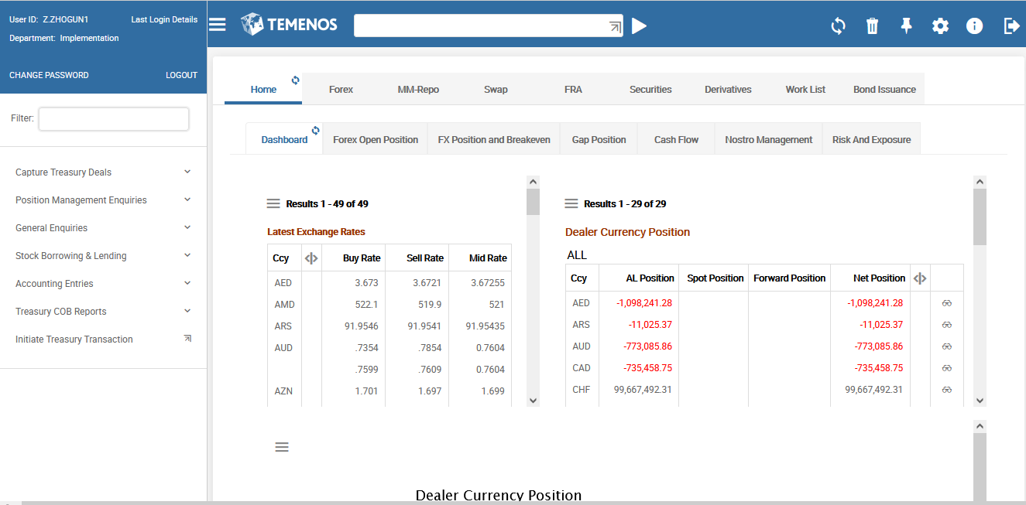
T24 Composite Screens
Tabbed Screen 1
Tabbed Screen 2
Menu
Enquiry 1
Enquiry 2
Notes:
A composite screen is a collection of various screens in T24.
A composite screen is divided into frames of different sizes, as shown.
Each frame displays a screen from T24. Each frame may contain T24 menus or Tabbed Screens or URLs or other content.
Composite screens are defined in the T24 application EB.COMPOSITE.SCREEN

Slide 27
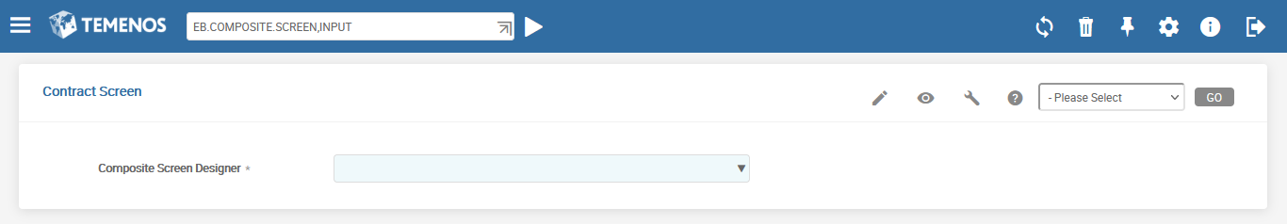
T24 Tabbed Screens
Executing new version creation or editing existing version:
Menu> Admin Menu> Implementation Utilities>Customization> Screen Designer > New Composite Screen
…or just EB.COMPOSITE.SCREEN,INPUT from command line:
Notes:
To create a composite screen use the built-in composite screen called SCREEN.DESIGNER. To launch a composite screen use the COS command. Specify COS <space> SCREEN.DESIGNER in the command line. This will launch the composite screen. Use the New Composite Screen link to create one. The id to your composite screen can be any alpha numeric text.

Slide 28
Demo 2 - Create Composite Screen
Create Tabbed Screen for grouping of different tasks execution in single browser window:
Upper half of the screen — TAB CUSTOMER.TAB, which is created in first Demo
Lower half of the screen — for opening of any new versions

Slide 29
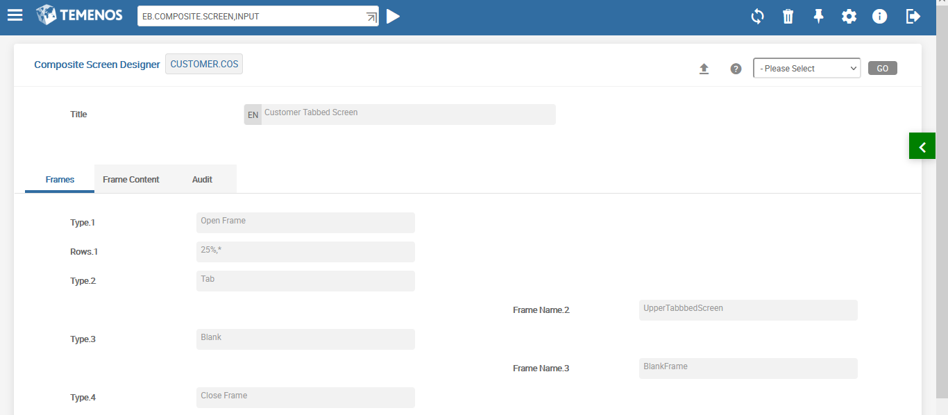
Demo 2 - Create Composite Screen
First Tab
Divides the window into two horizontal frames. The top frame occupies 25% of the window and the bottom frame – 75%
Top
Frame
Bottom
Frame
Notes:
Launch EB.COMPOSITE.SCREEN,INPUT version
The ID can be any alpha-numeric text
TITLE – Specify the title for the composite screen. The text specified here will be displayed as the description text of your composite screen.
A composite screen is divided into frames. Now where do you specify these framesets?
First Frame
CONTENT.TYPE – Here you specify the content of a frame. This field has various options in it, one among the options is OPEN.FRAME. By choosing the OPEN.FRAME option you tell the system to open a frameset.
ROWS – Is the frameset divided into rows or columns? If it is a row-wise separation then specify the split-up for each row. Here it is specified as 25%,* which implies that the entire window is divided into two frames. The top frame occupies 25% of the entire browser window and bottom frame occupies the remaining 75%
Second Frame
The top frame must contain the Tabbed Screen. Therefore in the next multi-value field of CONTENT.TYPE choose Tab.
Define the contents of the bottom frame.
Third Frame
CONTENT.TYPE – Specify BLANK option to tell the system to display a blank space here.
Fourth Frame
Close the opened frame in CONTENT.TYPE 1 (Multivalue 1).

Slide 30
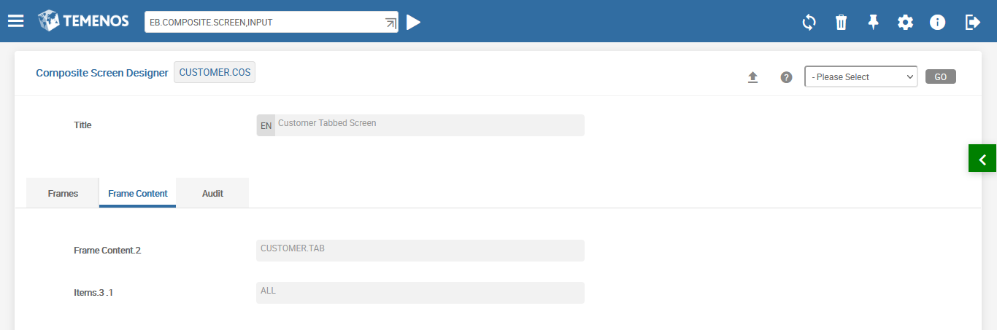
Demo 2 - Create Composite Screen
Second Tab
Notes:
CONTENT – Here you specify the content of the frame i.e., the name of Tabbed Screen
ITEMS – In the empty frame you may launch enquiries, versions or any unassigned requests. The field ITEMS is used to define what requests should be sent to this blank frame. The request is assigned to a window by running through each item until a valid match is found for the request. When you choose the ALL option here you tell the system to launch all unassigned requests in this frame.

Slide 31
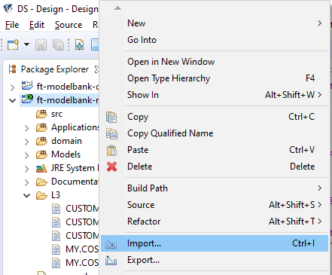
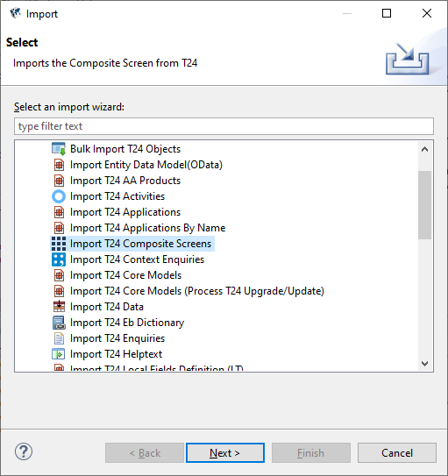
Demo 2 - Create Composite Screen
Import this screen via Design Studio and generate code:

Slide 32
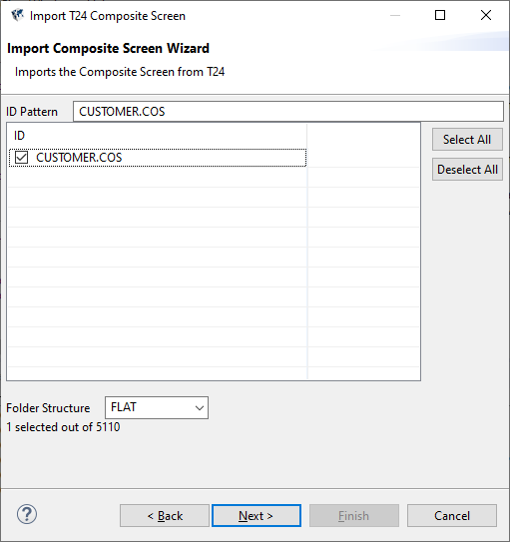
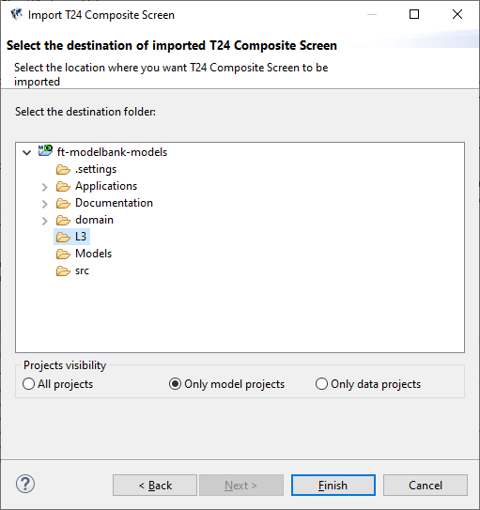
Demo 2 - Create Composite Screen
Import this screen via Design Studio and generate code:

Slide 33
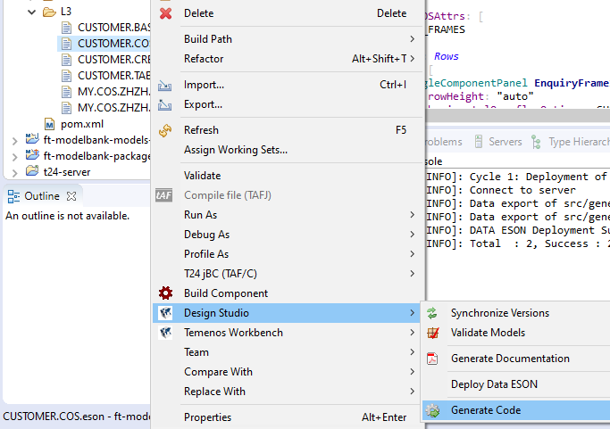
Demo 2 - Create Composite Screen
Import this screen via Design Studio and generate code:

Slide 34
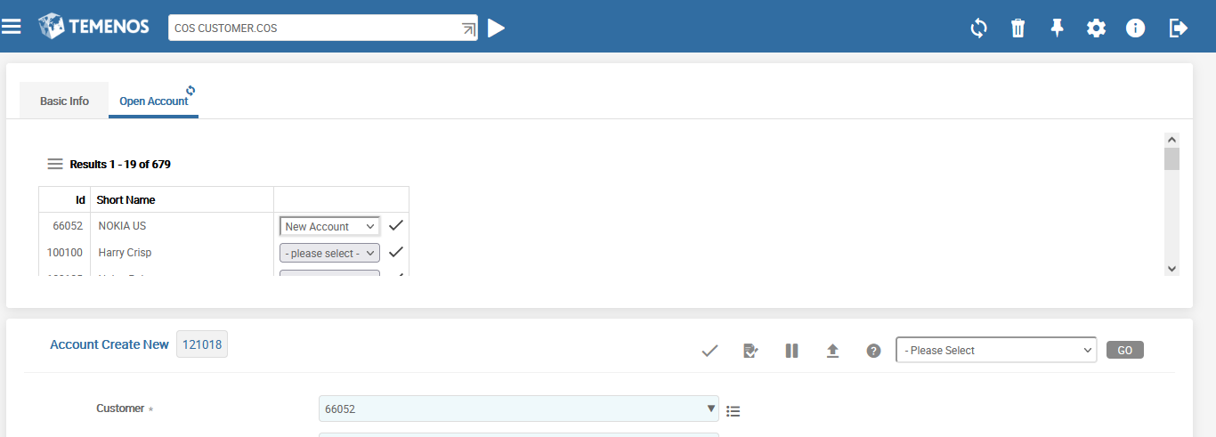
Demo 2 - Create Composite Screen
Launch COS CUSTOMER.COS from command line:
New content is launched in lower part

Slide 35
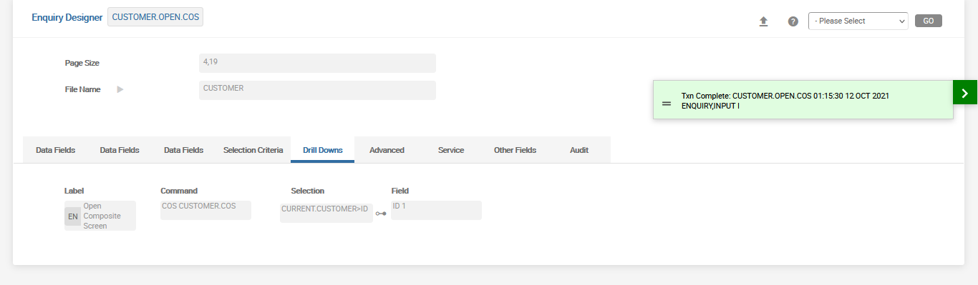
Demo 2 - Create Composite Screen
How to open COS CUSTOMER.COS screen wit predefined customer?
CURRENT variable could be used. Let’s create new Enquiry and fill it:
Notes:
ENQ CUSTOMER.CREATE.ACCOUNT could be copied to create new ENQ CUSTOMER.OPEN.COS

Slide 36
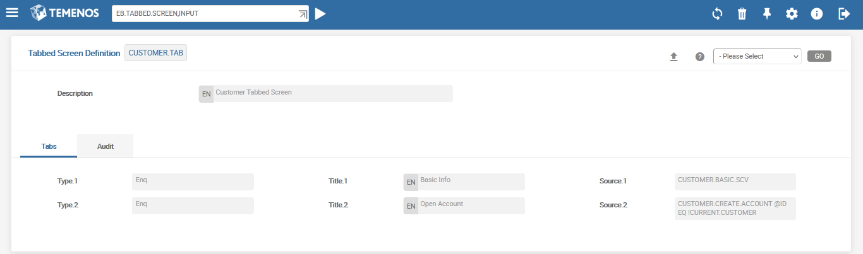
Demo 2 - Create Composite Screen
Also we should add receiving of CURRENT.CUSTOMER variable on Tabbed Screen:
For CUSTOMER.BASIC.SCV we do not need to add variable because it is already used in Predefine Selection of this Enquiry.
Notes:
ENQ CUSTOMER.CREATE.ACCOUNT could be copied to create new ENQ CUSTOMER.OPEN.COS

Slide 37
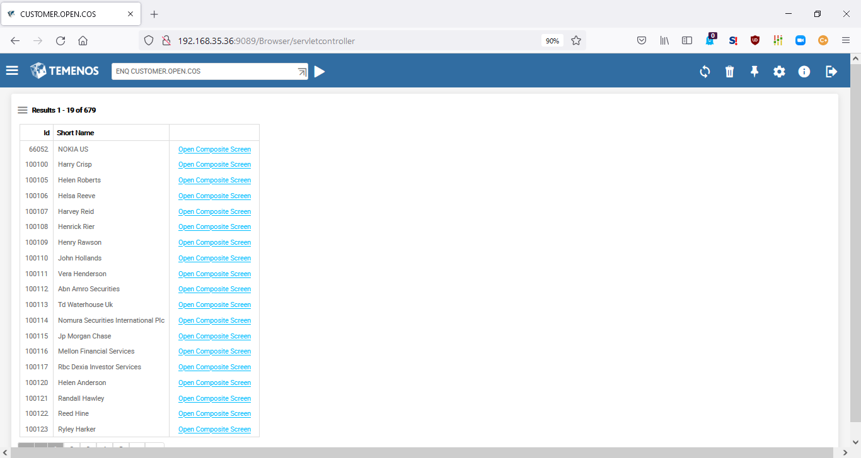
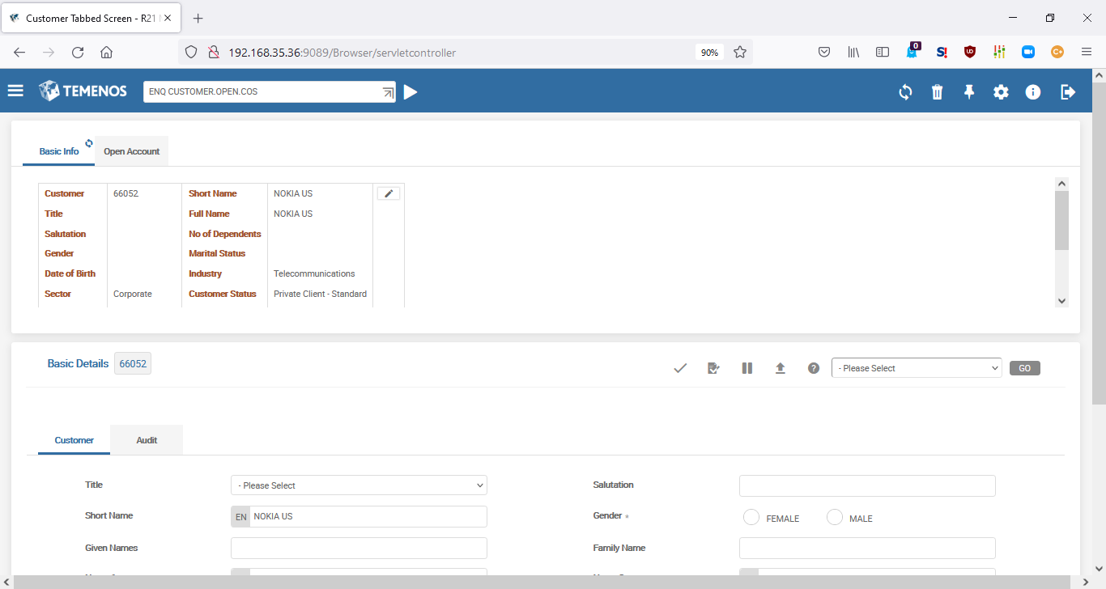
Demo 2 - Create Composite Screen
ENQ CUSTOMER.OPEN.COS
COS CUSTOMER.COS
Notes:
ENQ CUSTOMER.CREATE.ACCOUNT could be copied to create new ENQ CUSTOMER.OPEN.COS

Slide 38
Workshop - 2
Design a composite screen in T24 to launch the given enquiries
The enquiry to be launched on the top (horizontal) frame is %CUSTOMER
The enquiry to be launched on the bottom (horizontal) frame is %ACCOUNT
Define your own other necessary parameters (names, size etc.)
Launch your created COS
Notes:
The workshop tests your understanding on composite screen. The requirement is as follows,
1. Design a composite screen in T24 to launch the given enquiries
1. 1 The enquiry to be launched on the left frame is LD.COMMITMENT.DRAWING
1.2 The enquiry to be launched on the right frame is LD.LOAN.TODAY

Slide 39
T24 Composite Screens
Creating Composite Screens
from Design Studio

Slide 40
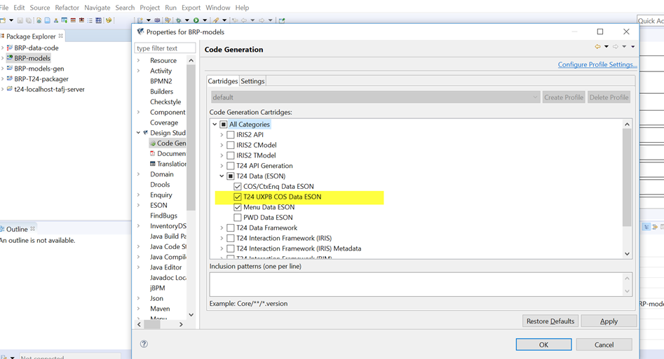
Tabbed and Composite Screens in UXP
First thing that you should do, make sure that enabled the highlighted plugin before code generation

Slide 41
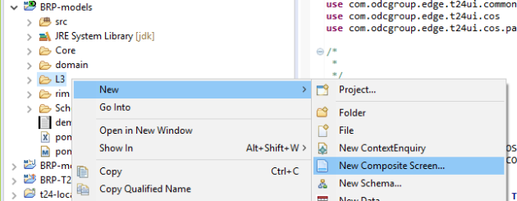
Tabbed and Composite Screens in UXP
Using Design Studio, right-click L3 and go to New > New Composite Screen
Click Finish

Slide 42
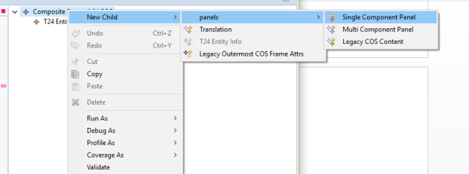
Tabbed and Composite Screens in UXP
Right-click Composite Screen and go to New Child > panels > Single Component Panel.

Slide 43
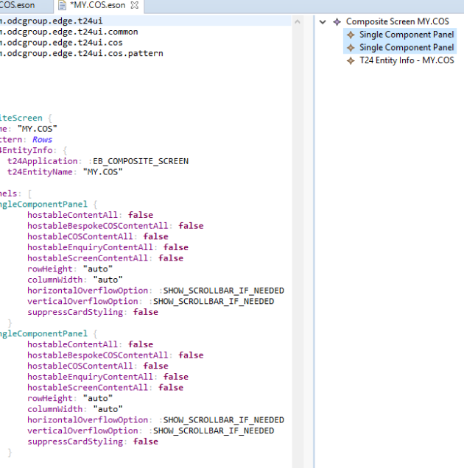
Tabbed and Composite Screens in UXP
Create two panels, which are top and bottom panels. The corresponding properties appear on the left side of DS

Slide 44
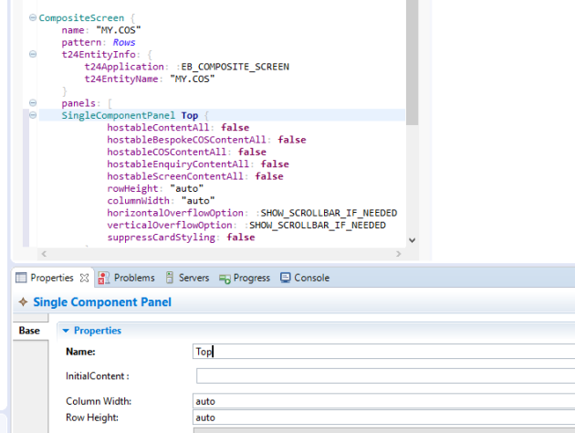
Tabbed and Composite Screens in UXP
Enter names for both the panels.

Slide 45
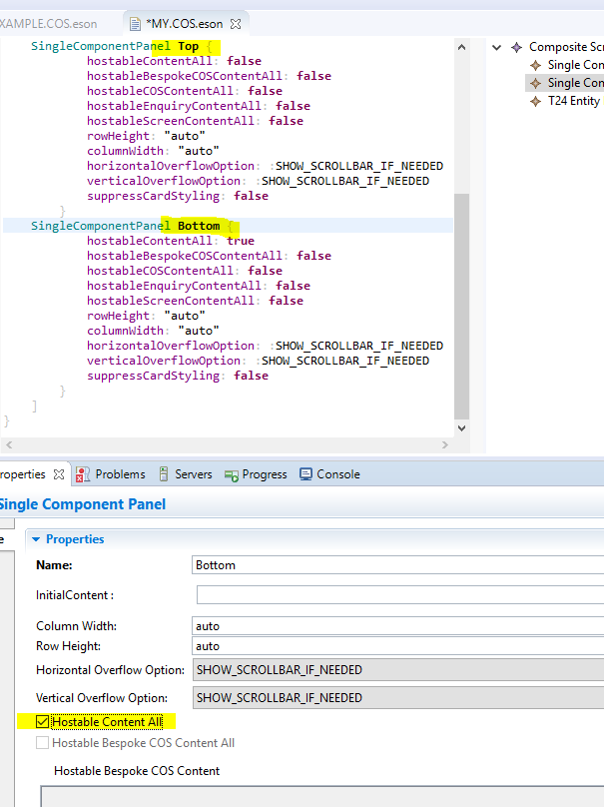
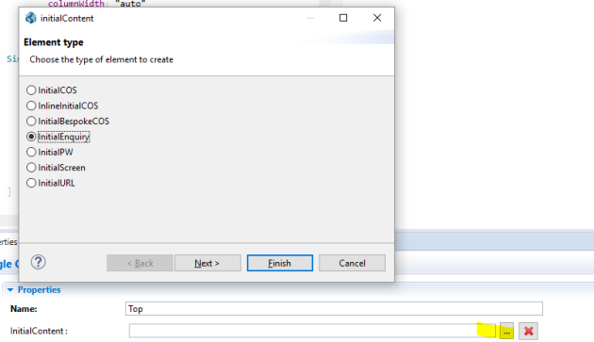
Tabbed and Composite Screens in UXP
Select Hostable Content All while editing the bottom panel properties so that it displays any output from the top panel.
For the top panel, in the InitialContent field, select InitialEnquiry and then click Next.

Slide 46
Tabbed and Composite Screens in UXP
Select Hostable Content All while editing the bottom panel properties so that it displays any output from the top panel.
For the top panel, in the InitialContent field, select InitialEnquiry and then click Next.

Slide 47
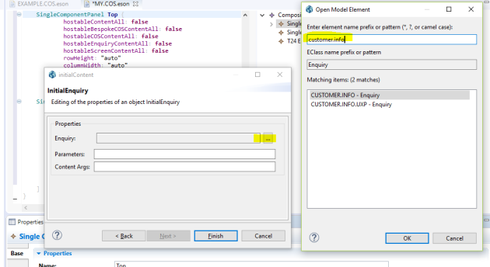
Tabbed and Composite Screens in UXP
Select enquiry from the Enquiry field.
Click Finish

Slide 48
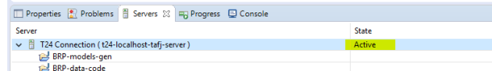
Tabbed and Composite Screens in UXP
Check if the Temenos Transact Connection in the Servers tab is in Active state.

Slide 49
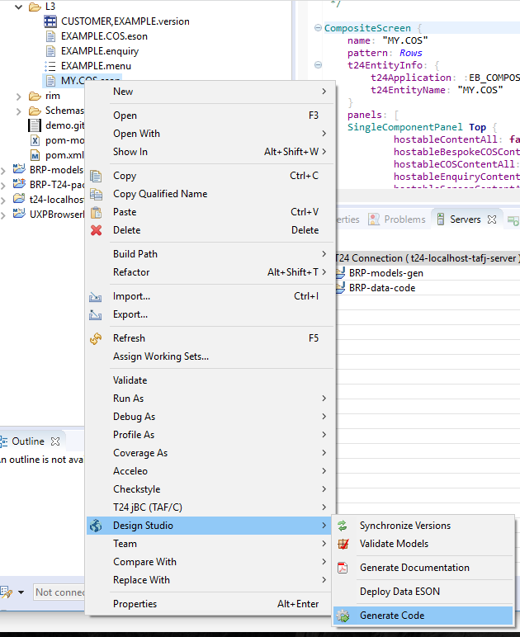
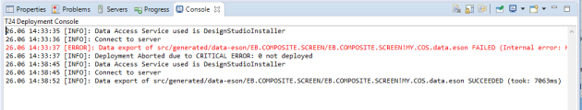
Tabbed and Composite Screens in UXP
Right-click COS file and go to Design Studio > Generate Code.
The Deployment Console provides you the feedback on success or failure of the generate code.

Slide 50
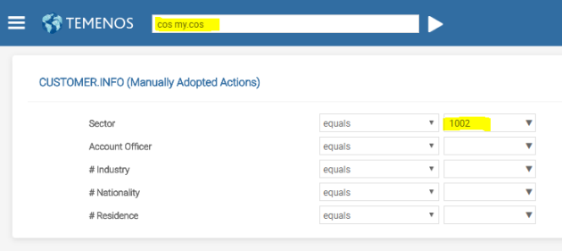
Tabbed and Composite Screens in UXP
Test created COS in the system.

Slide 51
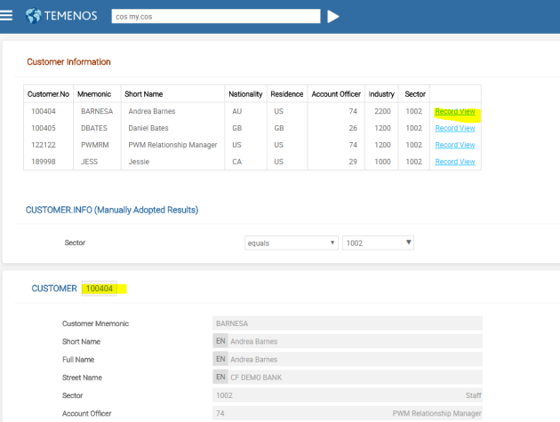
Tabbed and Composite Screens in UXP
Test created COS in the system.

Slide 52
Thank you for your time and attention!
FORANX LLC
Legal address:
35A, Ponomarenko str., 201 office, Minsk, 220015, Belarus
Tel.:+ 375 17 202 76 78
+ 375 17 202 76 79
Fax: + 375 17 362 34 22
Web-site: www.foranx.by
Minsk, 2021

